Slide 1
RECAP
A practical Test for Sustainable Remediation Assessment Tools
Notes:
Greetings,
In this presentation, we will provide a brief overview of the existing sustainable remediation assessment tools and guide you on how to determine if the tool you are using is appropriate.

Slide 2
History – Why SR now?
3. Sustainable Remediation
1. Multifunctional
Social
Bearable
Equitable
Sustainable
Environmental
Viable
Economical
2. Risk-Based Land Management (BATNEEC)
Notes:
To begin, it is essential to gain an understanding of the historical context of soil remediation policies. Initially, the primary policy concerning soil was multifunctional, which aimed to clean the soil to make it usable for any purpose in society. However, this approach was soon deemed impractical from an economic standpoint, as the only solution was to excavate and dispose of the contaminated soil. In terms of sustainability, the multifunctional policy is viewed as a balance between society and environmental concerns, but it does not consider economic factors. As a result, risk-based land management policies were implemented to prioritize sites and avoid harming the economy. These policies remain prevalent today, but after a couple of decades, they have led to limitations on society. Specifically, we see a lot of land being taken up by urban sprawl due to contaminated land not being adequately remediated to meet societal needs. For example, cities require more residential areas, schools, and parks, but much of the former industrial land has only been cleaned to an acceptable level for industrial use. This results in the need to build housing and parks farther away from city centers, often on agricultural land, leading to urban sprawl. This has been deemed unsustainable from a societal perspective, which has led to the concept of sustainable remediation, which seeks to balance the economy, the environment, and society.

Slide 3
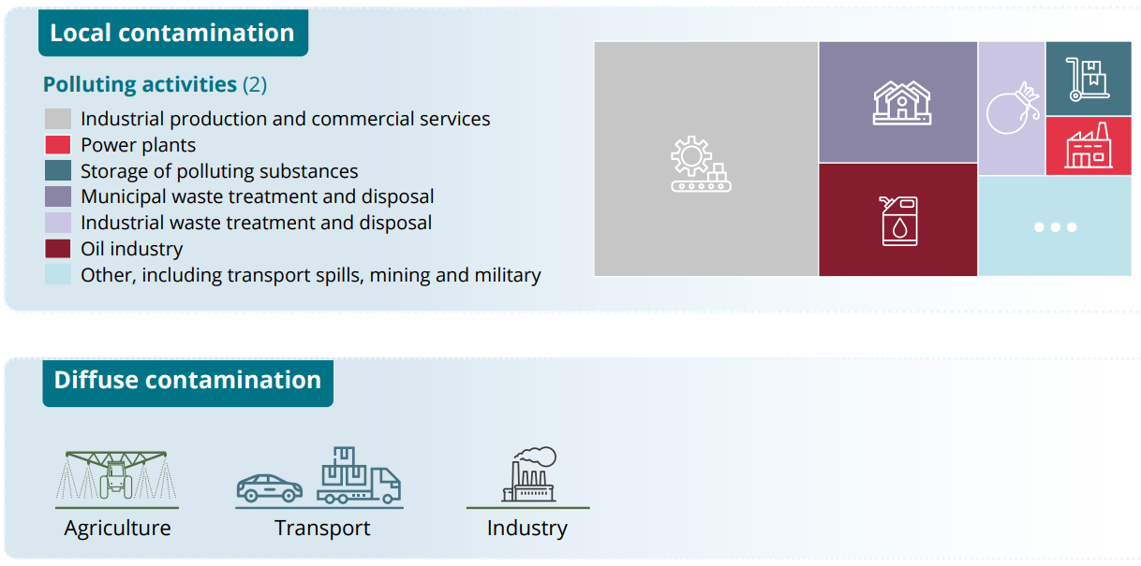
Land take (Europe)
Notes:
As depicted in this slide, the rate of land take in the European Union and neighboring nations has been significant over the past few decades. It is evident that the current pace of land usage is not sustainable.

Slide 4
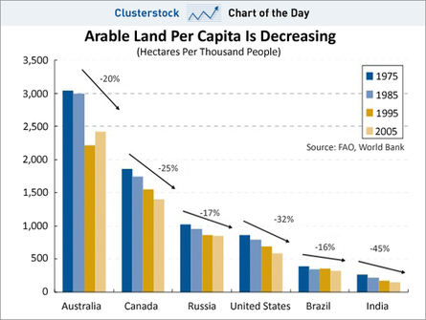
Notes:
The reduction in arable land per capita is not limited to the European Union alone. As illustrated in this slide, it is evident that this trend is occurring across all continents worldwide.

Slide 5
Sanity check: a RECAP soil treatment technology
apid
ffective
limate-Friendly
ffordable
redictable
R
E
C
A
P
Notes:
Our proposed solution involves evaluating the sustainability of your project by scoring it according to five key criteria. Firstly, we consider whether the project is rapid, meaning that the end of the remediation process must be achievable within a reasonable timeframe. In other words, the person responsible for designing the project should also be accountable for its outcomes, and long-term remediation processes that span over decades cannot be considered sustainable.
Secondly, we assess the effectiveness of the project, ensuring that no contamination is left behind for future generations to deal with.
Thirdly, we evaluate the project's climate friendliness, taking into account the energy used in the remediation process and striving to minimize energy consumption as much as possible.
Fourthly, we consider the affordability of the project, ensuring that it is cost-effective and does not exceed the cost of the land or its value to society.
Lastly, we prioritize the predictability of the solution, ensuring that secured solutions are compared to unsecured solutions with potential risks that the technology may not work.

Slide 6
Thank you for your attention !

